Slide 1
LAN
A computer network that spans a relatively small area. Most often, a LAN is confined to a single room, building or group of buildings

Slide 2
Features Of LAN
The sharing of resources
Data transfer and e-mail
Improve the reliability
Easy to distributed processing

Slide 3
Components of LANs
Network Adapter
Network Medium
Cable Connectors
Power Supply
Hub/Switch/Router
Network Software

Slide 4
LAN Standards
Network standards define guideline that specify the way computers access the medium to which they are attached.
The guideline also describe the type of medium used, the speeds used on different type of physical cable or wireless technology.
The well known standards adopted by the IEEE are 802 standards.

Slide 5
IEEE802 standards
802.3
802.4
802.5
802.7
802.8
802.11

Slide 6
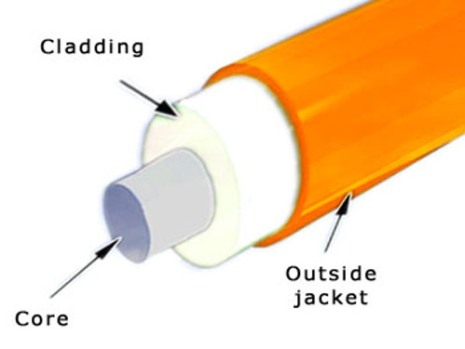
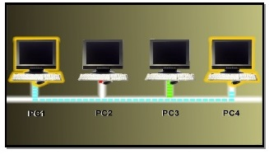
802.3 Ethernet LAN
It is the standard for an Ethernet LAN.
In 802.3, Ethernet refers to the physical cabling, while the way data is transmitted through the cable is called Carrier Sense Multiple Access/Collision Detection(CSMA/CD)
This method of transmission requires that only one device in network can transmit at a time. If another device can sense that a transmission is already in the cable, it will have to wait

Slide 7
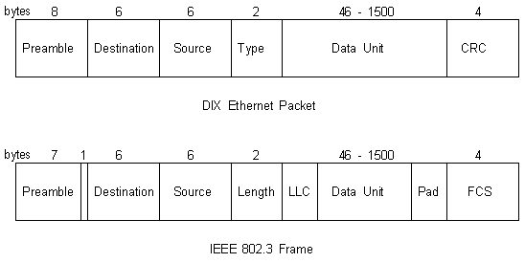
802.3 Frame Format

Slide 8
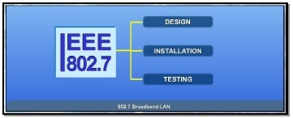
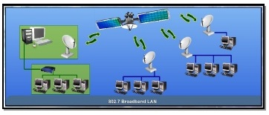
802.7 Broadband LAN
It is a Standard Specification for Broadband LAN
This 802.7 standard provides specifications for the design,installation and testing needed for broadband transmission
Broadband transmission allow simultaneous multiple transmission or signal using different communication channels at the same time

Slide 9
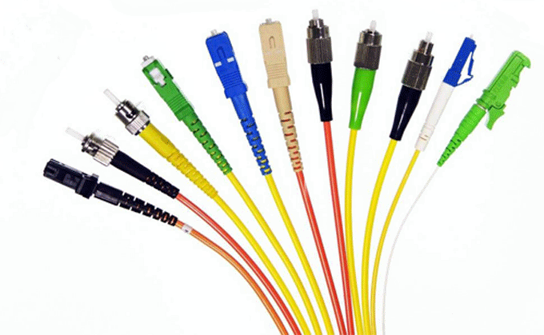
802.8 Fibre-Optic LAN and MAN
Specification for Fibre-Optic LAN and MAN are given under the 802.8 standard.
This standard gives the recommendation for the configuration and testing of fibre-optic Local Area Network and Metropolitan Area Networks

Slide 10
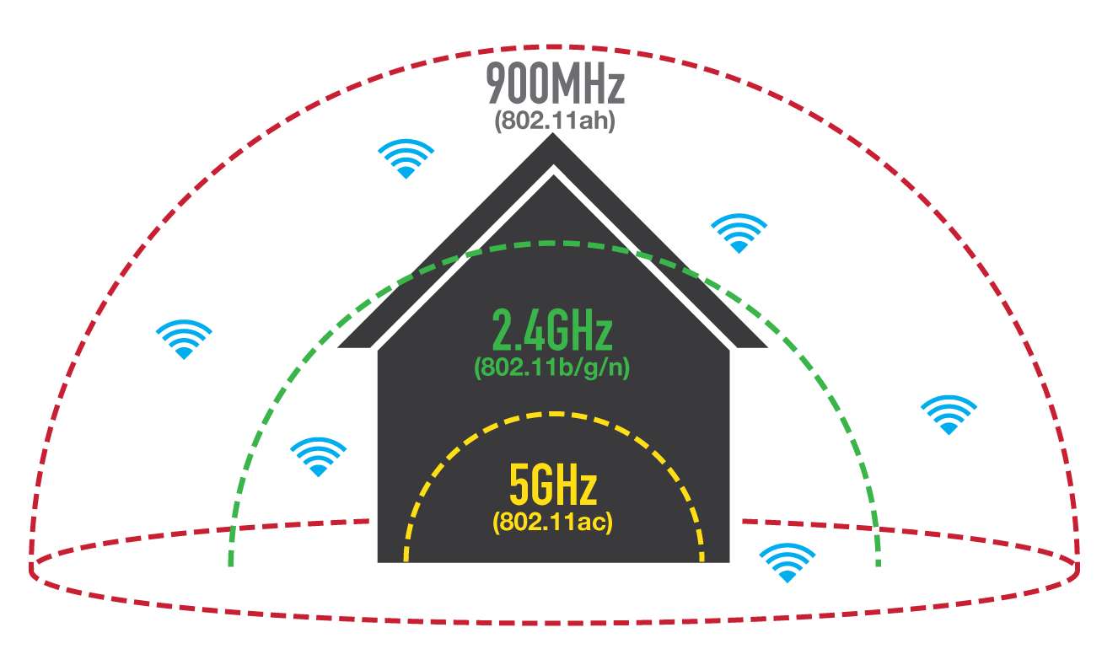
802.11 Wireless LAN
This standard defines communication between a wireless computer or client and an access point or between two wireless computers or clients.
The 802.11 standard uses the 2.4GHz frequency band to transmit data up to 2Mbps.

Slide 11
Channel Access Method
Channel access method (CAM) is used to allow network terminals to share media capacity through a multipoint transmission medium. CAM examples include bus, hub, wireless and ring networks.
A channel access scheme is based on a multiplexing method, which allows several data streams or signals to share the same communication channel or physical medium.
It is also based on a multiple access protocol and control mechanism known as media access control (MAC).

Slide 12
Channel Access Method protocol features
Physical layer multiplexing
The media access control layer, which handles addressing and collision prevention
Token passing
Polling, a continuous slave/master data querying process
Contention or node network access competition

Slide 13
Channel Access Method Schemes
Frequency division multiple access
Time division multiple access
Code division multiple access
Spatial division multiple access

Slide 14
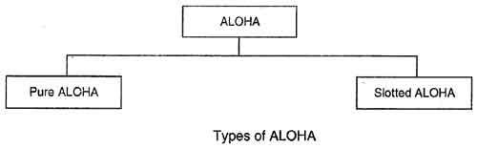
ALOHA
ALOHA is a system for coordinating and arbitrating access to a shared communication Networks channel.

Slide 15
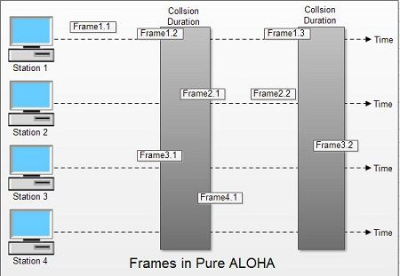
Pure Aloha

Slide 16
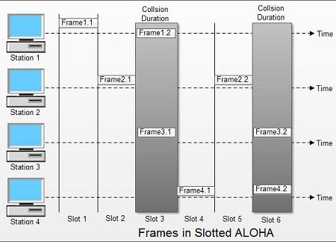
Slotted Aloha

Slide 17
Carrier Sense Multiple Access
Carrier Sense Multiple Access (CSMA) is a network protocol that listens to or senses network signals on the carrier/medium before transmitting any data.
CSMA works on the principle that only one device can transmit signals on the network, otherwise a collision will occur resulting in the loss of data packets or frames.

Slide 18
CSMA access modes
1-persistent
Non-persistent
P-persistent
O-persistent

Slide 19
CSMA with collision detection
A set of rules determining how network devices respond when two devices attempt to use a data channel simultaneously.
Standard Ethernet networks use CSMA/CD to physically monitor the traffic on the line at participating stations. If no transmission is taking place at the time, the particular station can transmit.
If two stations attempt to transmit simultaneously, this causes a collision, which is detected by all participating stations.
After a random time interval, the stations that collided attempt to transmit again.

Slide 20
CSMA with Collision Avoidance
In contrast to the Carrier Sense Multiple Access/Collision Detect (CSMA/CD) protocol, which handles transmissions only after a collision has taken place, CSMA/CA works to avoid collisions prior to their occurrence.
CSMA/CA increases network traffic as it requires sending out a signal to the network even before transmitting any real data. This is to listen for any collision scenarios in the network and to inform other devices not to transmit.
A node listen to the broadcast channel for a pre-specified time frame to determine if another node is broadcasting on the channel inside the wireless range.

Slide 21
Token Passing
A type of CAM.
Uses a token, or series of bits, to grant a device permission to transmit over the network.
Whichever device has the token can put data into the network. When its transmission is complete, the device passes the token along to the next device in the topology.
System rules in the protocol specifications mandate how long a device may keep the token, how long it can transmit for and how to generate a new token if there isn't one circulating

Slide 22
Switching
Layer 2 Switching:- A L2 switch does switching only. This means that it uses MAC addresses to switch the packets from a port to the destination port .
Layer 3 Switching:- A L3 switch also does switching exactly like a L2 switch. A L3 switch is capable of having IP addresses and doing routing. For intra-VLAN communication, it uses the MAC address table. For inter-VLAN communication, it uses the IP routing table.

Slide 23
Fast & Gigabit Ethernet
Fast Ethernet:-
100BASE-T
100BASE-FX
Gigabit Ethernet:-
1000BASE-T twisted pair cable
1000BASE-X optical fiber
1000BASE-CX shielded balanced copper cable

Slide 24
Switchs & Hub
Hub:- Hub is a network hardware device for connecting multiple Ethernet devices together and making them act as a single network segment.
A hub works at the physical layer of the OSI model.
Switch:-A network switch is a multiport network bridge that uses hardware addresses to process and forward data at the data link layer of the OSI model. Some switches can also process data at the network layer (layer 3) by additionally incorporating routing functionality. Such switches are commonly known as layer-3 switches or multilayer switches.

Slide 25
Routers & Gateways
Router:- A router is a networking device that forwards data packets between computer networks. Routers perform the traffic directing functions on the Internet.
Gateways:-A gateway, is a passage to connect two networks together that may work upon different networking models. They basically works as the messenger agents that take data from one system, interpret it, and transfer it to another system. Gateways are also called protocol converters and can operate at any network layer.

Slide 26
Bridges
Bridge:-
A bridge operates at data link layer. A bridge is a repeater, with add on functionality of filtering content by reading the MAC addresses of source and destination. It is also used for interconnecting two LANs working on the same protocol.

Slide 27
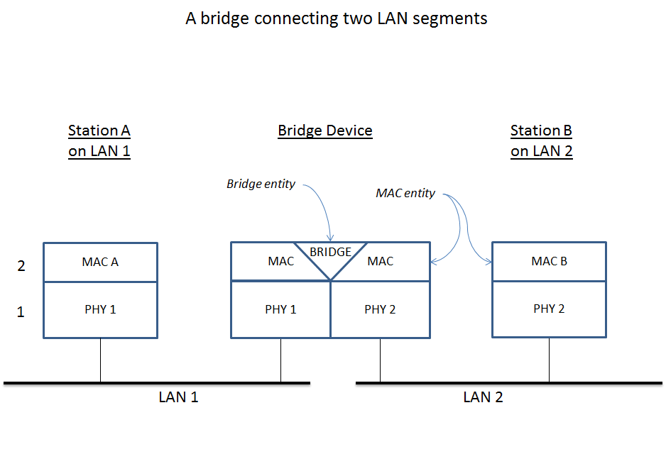
Bridges

